Slide 1
Sentiment Analysis on Amazon Reviews using ML and DL
Manal Asghar and Maryam Hannan
Fa24msds0004 and Fa24msds0021

Slide 2
Introduction
Sentiment analysis is an important NLP task
Used to classify text into positive or negative sentiment
Amazon reviews provide large-scale real-world text data
This project compares ML, DL, and Transformer-based models

Slide 3
Dataset
Amazon Polarity Dataset (HuggingFace)
Binary sentiment classification (Positive / Negative)
Review title and content merged
Dataset split into:
Training set
Validation set
Test set

Slide 4
Preprocessing
Text cleaning
Tokenization
Label encoding
Train / Validation / Test split
Padding and truncation (for deep models)

Slide 5
Models Implemented
Baseline Model: Logistic Regression (TF-IDF)
Deep Learning Model: GRU
Advanced Enhancement:
  BERT fine-tuning (Transfer Learning)

Slide 6
Model Architecture
Logistic Regression
TF-IDF features
Linear classifier

Slide 7
Model Architecture
GRU
Embedding layer
GRU layer
Dense output layer

Slide 8
Model Architecture
BERT
Pre-trained transformer
Fine-tuned for sentiment classification

Slide 9
Evaluation Metrics
Accuracy
Precision
Recall
F1-score
Confusion Matrix

Slide 10
Evaluation Metrics
Model | Accuracy | Precision | Recall | F1-score
Logistic Regression | 0.90 | 0.90 | 0.91 | 0.91
GRU | 0.49 | 0.95 | 0.96 | 0.95
BERT | 0.95 | 0.95 | 0.96 | 0.95

Slide 11
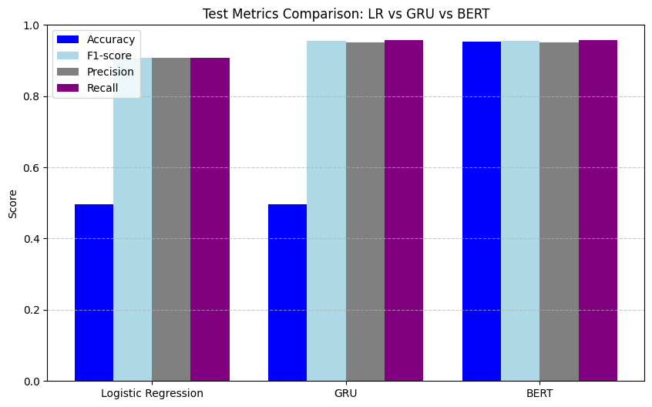
Results Visualization

Slide 12
Discussion
Logistic Regression lacks contextual understanding
GRU captures sequence information but is slow and unstable
BERT performs best due to pre-trained contextual representations
Transfer learning significantly improves performance

Slide 13
Conclusion
BERT achieved the highest accuracy and balanced metrics
Traditional models serve as good baselines
Transformer-based models are most effective for sentiment analysis

